Slide 2
Inaugural Session

Slide 3
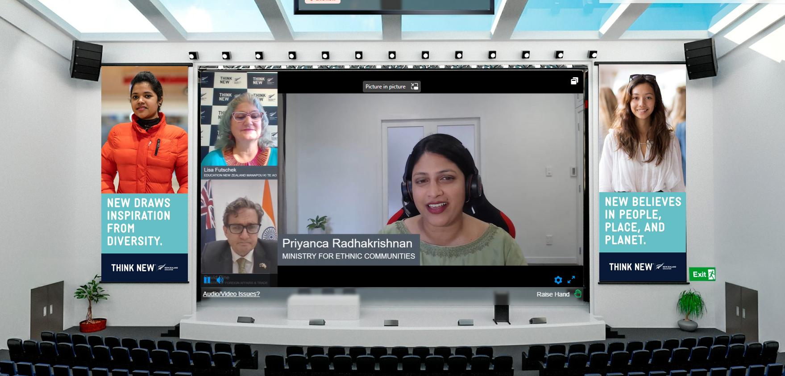

Slide 4
Panel Discussion – Leading with Authenticity

Slide 5
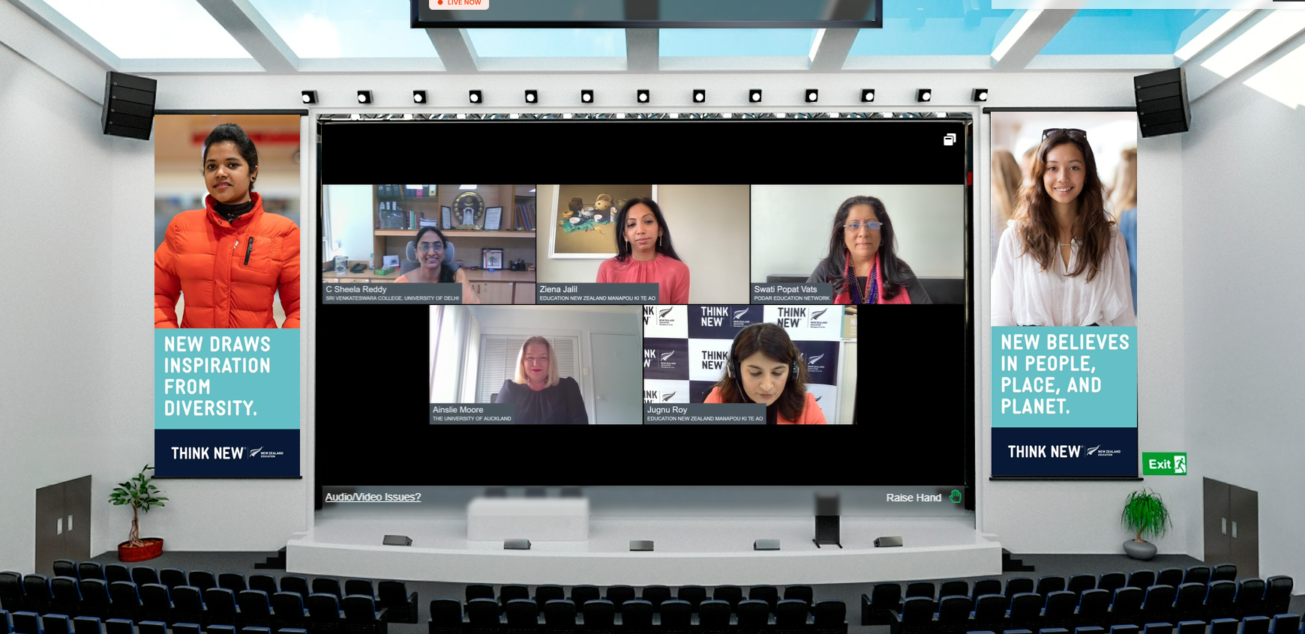

Slide 6
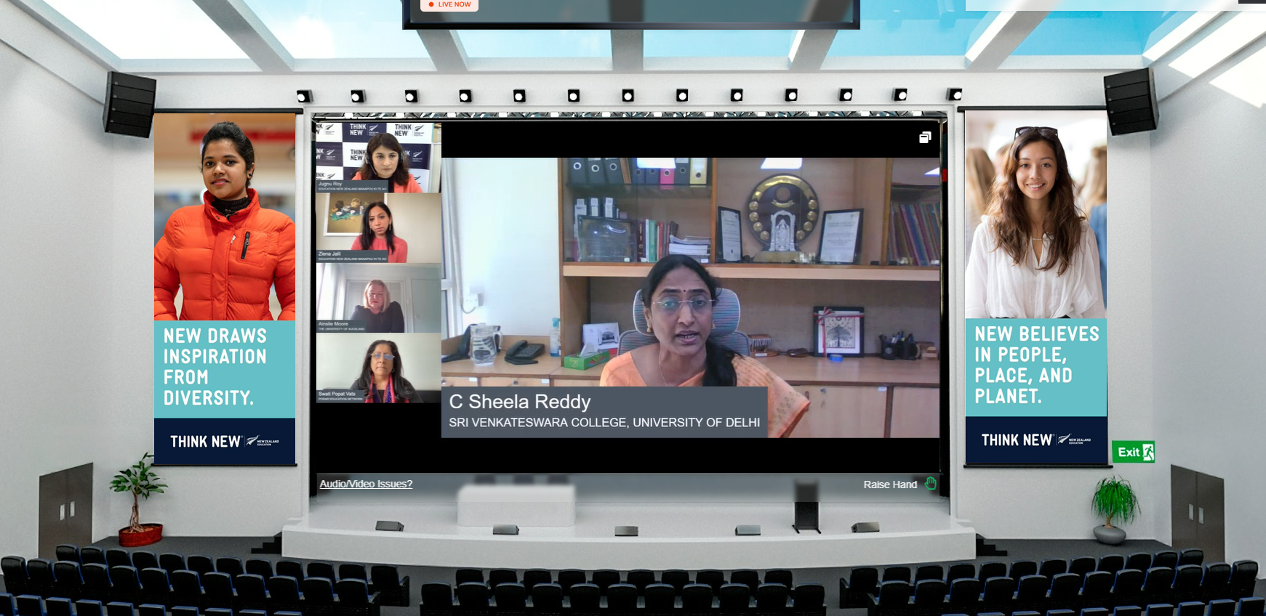

Slide 7
